Slide 1
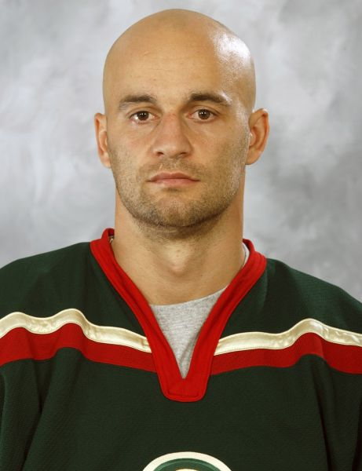
Pavol
Demitra

Slide 2
Pavol Demitra (* 29. November 1974 - † 7. September 2011) was a Slovak ice hockey player. Recently, he playedin the Russian KHL club Lokomotiv Yaroslavl. He was a a captain of Slovak hockey team. Last time, he played in the match against Denmark on 9 May 2011.

Slide 3
Club Hockey Career
Pavol Demitra started with hockey in his hometown. He began to play senior hockey in te season 1992/93. He played in Czech-Slovak League for Dukla Trencin. He also played in Ottawa for the team of the Prince Edward Island Senators.

Slide 4
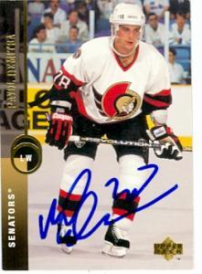
Pavol Demitra
in Ottawa Senators

Slide 5
Representation
Pavol Demitra represented Slovakia at the Championship in 1996, 2003 (bronze), 2004, 2005, 2007, 2011 and the Olympic Games 2002, 2006, 2010 and World Cup in 1996 and 2004. Totally, he played in 77 representative matches and gave 27 goals. He wore jersey number 38.

Slide 6
His Family
Pavol Demitra has been married since 2002 and his wife had two children: son Lucas (* 2003) and daughter Zara (* 2005).

Slide 7
Demitra´s Death
Pavol Demitra died on 7 September 2011 in a plane Yak-42 that killed the entire Lokomotiv Yaroslavl hockey team.

Slide 8
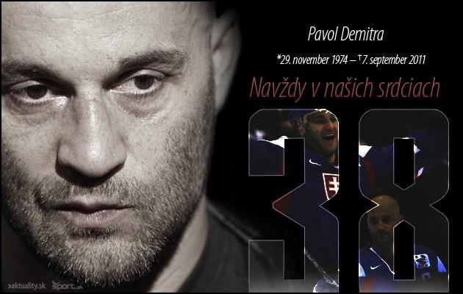
Never Forget You :/
R.I.P

Slide 9
Picture sources:
http://img.aktuality.sk/stories/NAJNOVSIE_FOTKY/OSOBNOSTI/SHOWBIZ/pavol_demitra_profil_2011_3.jpg
http://images.monstermarketplace.com/autographed-sports-memorabilia-and-display-cases/pavol-demitra-autographed-hockey-card-ottawa-senators-1994-upper-deck-216-221x300.jpg
http://nahodsa.sk/blog/wp-content/uploads/2013/03/862186-img-pavol-demitra-hokej-hokejista-rodina-manzelka-deti-april2011-crop.jpg
http://img.cas.sk/img/4/gallery/1090649_pavol-demitra-trencin-exhibicny-zapas-fotografie-fotky-zverejnili.jpg?hash=b4b1465264d981b2c5816f7115360d57
http://img.sport.sk/stories/2005/Sport/Hokej/Reprez/Slovensko/grafika-Demitra-1.jpg

Slide 10
Thanks for your attention ! :))
Made By : Miška Pekárová

