Slide 1
Tomáš derzsi
Depeche Mode

Slide 2
Something about the group
It is an English electronic music band formed in 1980 in Basildon Essex.
The group's original line-up consisted of Dave Gahan, Martin Gore, Andy Fletcher.
The band's first album appeared in1980
A highlight of this era was the band's concert at the Pasadena Rose Bowl (a crowd of 60,000 people).

Slide 3
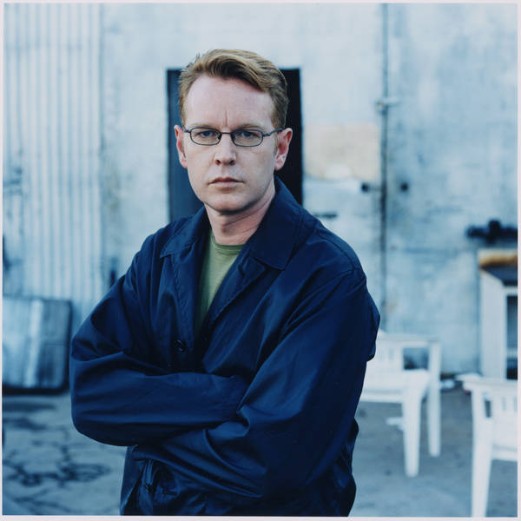
Group members
Martin Gore-songwriter, the original singer, guitarist and keyboard player.
David Gahan -the leader singer, songwriter, previously he played the other musical instruments.
Andrew Fletcher-keyboard player, manager, occasionally he plays the other musical instruments.

Slide 4
My idea
I like Depeche Mode because they have super songs and amazing concerts.
My favourite singer is Dave Gahan and my favourite song is Depeche Mode - Personal Jesus.
I want to go to their concert in Bratislava 6.2.2014
One ticket will cost 25 euro.

Slide 5
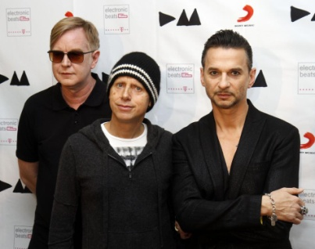
The top songs on YouTube
Personal Jesus http://www.youtube.com/watch?v=u1xrNaTO1bI
Heaven http://www.youtube.com/watch?v=Fy7FzXLin7o
Enjoy The Silence http://www.youtube.com/watch?v=diT3FvDHMyo

Slide 6
I want to sing a song !
http://www.youtube.com/watch?v=diT3FvDHMyo
(With the captions) ☺

Slide 7
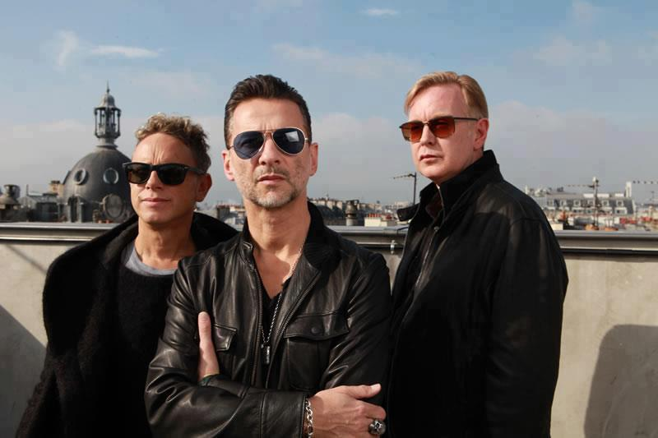
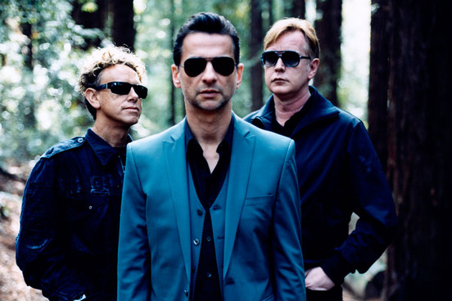
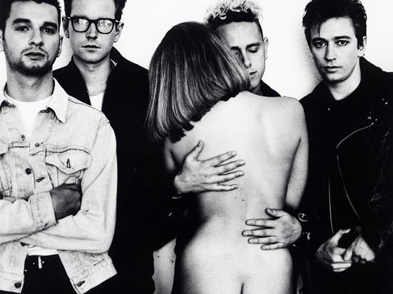
Gallery

Slide 8
This is their logo
Born in 1980 !!!

Slide 9
Thanks for watching ☺
See you! ☺

Slide 10
Picture sources
http://www.toneluster.com/wp-content/uploads/2012/12/Depeche_Mode.jpg
http://depechemode.sk/obrazky/obsah/zapisy/2013/2014_depeche-mode-bratislava-2014.jpg
http://mhvorecky.files.wordpress.com/2006/06/depeche_mode1.jpg
http://nme.assets.ipccdn.co.uk/images/gallery/2012DepecheModePR200212.jpg
http://www.supermusic.sk/obrazky/2601138_tour_bg.jpg
https://encrypted-tbn1.gstatic.com/images?q=tbn:ANd9GcRTCk9uFzjMqwoxgRgg7NyamMzPlfZ34woVACyFWirlNQVkFE9zrQ
https://encrypted-tbn1.gstatic.com/images?q=tbn:ANd9GcRf8eEqC7ijNW6wac89NGlfrUb9iqN_hrffRrTFYYPTeAhz4OWw
http://upload.wikimedia.org/wikipedia/commons/thumb/a/a5/Depeche-mode-martin-gore2.jpg/220px-Depeche-mode-martin-gore2.jpg
http://www.supermusic.sk/obrazky/75036_ANDY_FLETCHER_1_jpg_big.jpg

