Slide 1
My favourite animal

Slide 2
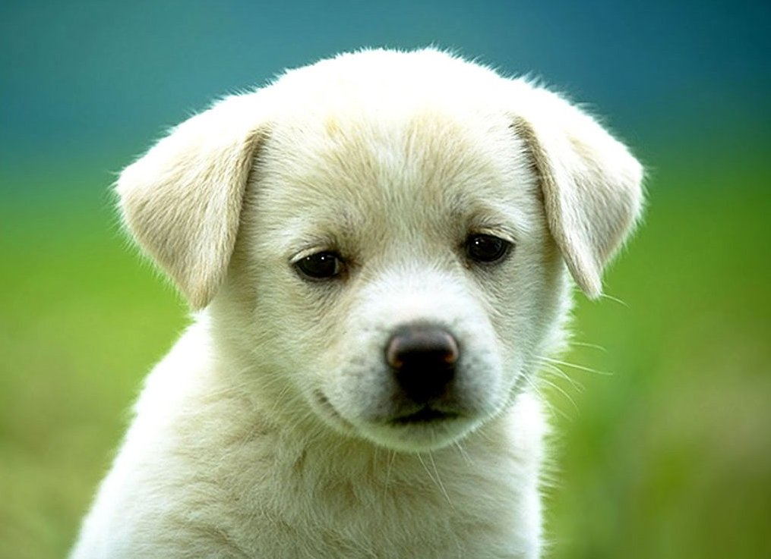
My favourite animal is a dog.

Slide 3
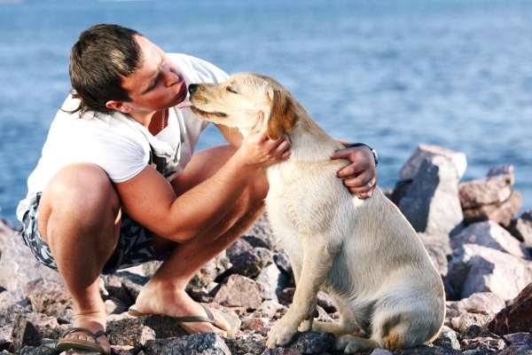
Dog is the best friend of a man.

Slide 4
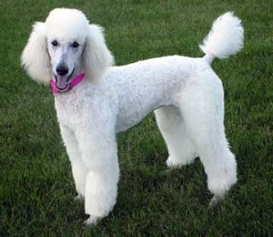
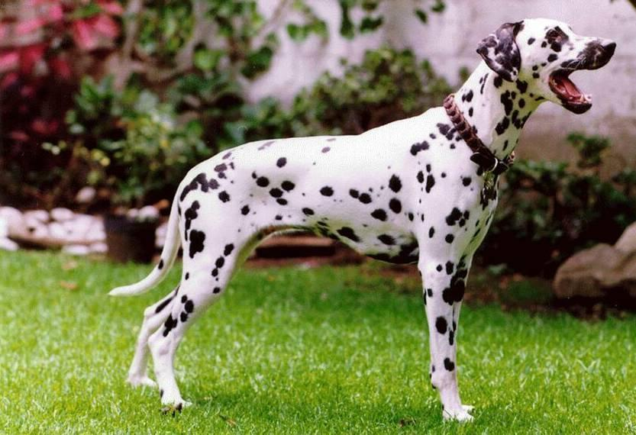
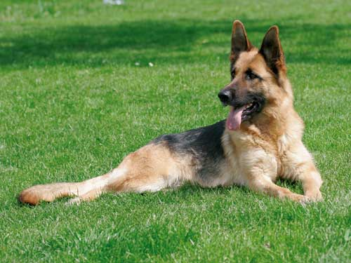
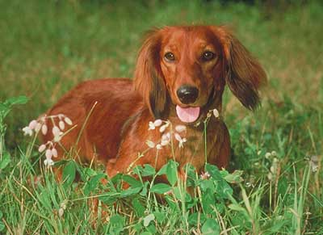
There are several breeds of dogs such as poodle, wolfhound, dachshund or Dalmatian dog.

Slide 5
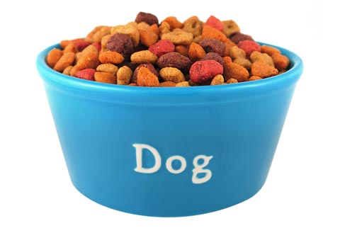
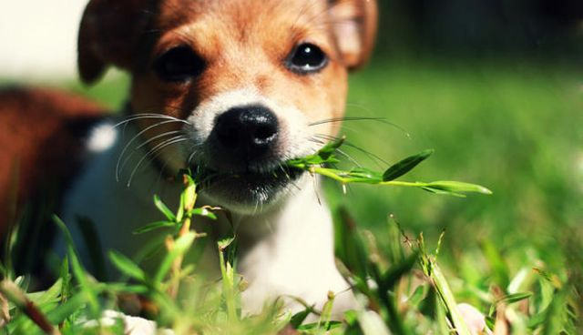
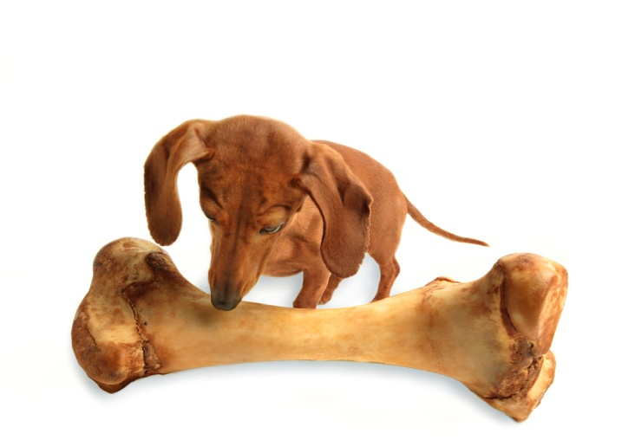
Dogs are carnivores. They like eating grass, dog food, bones and meat.

Slide 6
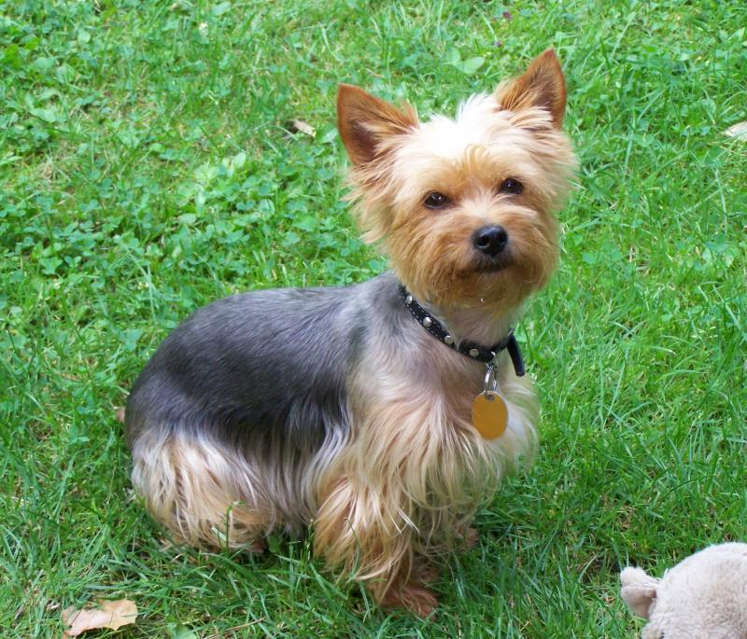
I have got a dog. My dog is brown. Its name is Ricky. It likes walking.

Slide 7
PICTURE Sources
http://navzdypriatelia.mypage.cz/menu/pes-najlepsi-priatel-cloveka
http://www.aktuality.sk/clanok/191645/co-si-myslia-psy/
http://www.dogsk.sk/kynologia/revue/foto2005/vlciak09_05b.jpg
http://www.corey.estranky.sk/img/picture/19/pud02.jpg
http://www.ipes.sk/sites/default/files/jazvecik_0.jpg
http://www.celysvet.cz/fotky/dalmatin_1.jpg
http://www.chiwawadog.org/wp-content/uploads/2013/06/Dog-Food.jpg
http://poochtastic.com/images/Little_dog_with_bone.JPG
http://4.bp.blogspot.com/-W86R8Hpt6Pw/Tm1odEMQfLI/AAAAAAAAGBc/1BKS07Mfe18/s1600/eat%2Bgrass.jpg
http://www.pejskar.cz/foto/clanky/resized/245-0-yorksirsky-terier-jorksirsky-terier.jpg

